Slide 1
Evolving systems design from unreliable rpc to resilience with Linkerd
Edward Wilde

Slide 2
A story about unreliable RPC
Notes:
5 years ago I joined a trading company
The system allow customers to shares, foreign exchange and commodities
The system was api driven and made up of more than 200 services, with many instances of each service, spread across two datacenters in active / active arrangement
The system worked well, however we sometimes got reports from customers that they would place a trade and nothing would happen
In this talk, I’m going to cover how we tried to solve that problem and look at some different types of architectures

Slide 3
Notes:
We will look into why we had those intermitant, problems. But first I would like to define a few terms
Monolith and microservice

Slide 4
Monolith architecture
Notes:
In a typical monolith architecture functionality / services are grouped together in modules and hosted in the same process
Modules communicate with each other using in-process function calls
Another characteristic of a monolith is that components share the same database

Slide 5
Monolith it’s not all bad
Simple to:
Develop
Deploy
Scale
Hard to:
Develop
Change
Scale
K
J
Notes:
Simple to develop
Allows you to rapidly develop software with a small team, test it in the market place without spending lots of money
Simple to deploy
Usually very simple to deploy. You are only installing one piece of software into an environment
Simple to scale
Hard to develop with multiple teams
Teams can step on each others toes
Each change could potentially effect all of the services. isolation is more difficult in a monolith, so full regression test may be needed
A change to one component or service requires releasing all services, since they are all hosted in a single process
As the application grows in size the complexity of the monolith can quickly become overwhelming for a developer to understand and maintain
Hard to scale
Whilst is simple to scale, it’s often not effective or can be wasteful. You can not scale services independently of each other

Slide 6
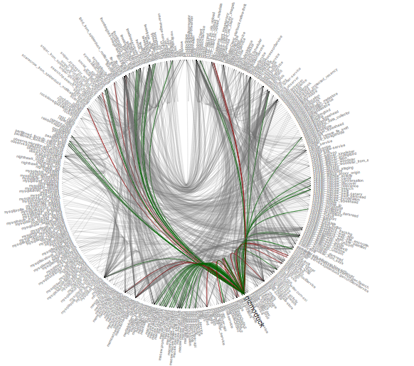
Microservices
Notes:
With microservices each component is split out into a separate service that runs in it’s own process
This is twitters architecture from a couple of years ago

Slide 7
Microservices architecture
Notes:
runs in it’s own process : be deployed and scaled independently form each other
rest
Developed independently, simplifying communication between teams
Deployed independently of others
persisting it’s own data separately from other services
can choose the best method for their service
small
easier to understand
quick to load and run
Services are also free to choose a different technology stack compared with the monolith

Slide 8
Components (some) of a microservices architecture
Notes:
I want to highligh some important components commonely seen in microservices architectures
Lets start with the api gateway

Slide 9
What is an api gateway?
Benefits
Single point of entry
Decoupling
Security
Authentication
Logging
Metrics
Request handling
Basic
Fan-out
Transformations
Draw backs (?)
More infrastructure
More hops
Quotas
Rate limiting
Notes:
Single point of entry for a platforms API:
Decoupling:
Public API separate from private API, api versioning
Insulate clients from how the services are partitioned
Security: (TLS, Mutual Auth, HMAC)
(Basic, OAuth, Openid, jwt etc..)
Cross cutting functionality can be implemented once
Router
Protects clients from needing to determine the location of service instance
Proxy requests to downstream services
Fan-out request, compose the results of many services into response to the client, reduces round trips
Transformations, can transform the request or response, polyfils

Slide 10
Open source API gateways
tyk.io
Commercial software
Notes:
In the interest of balance other api gateways are available from the usual suspects

Slide 11
Components (some) of a microservices architecture
Notes:
Containers refer to an operating system feature in which the kernel allows the existence of multiple isolated user-space instances.
Package

Slide 12
Containers and schedulers
Notes:
Scheduler makes sure the correct number and type of containers are running in the platform

Slide 13
Components (some) of a microservices architecture

Slide 14
Service discovery
Notes:
Sounds like DNS, the difference is that DNS was designed for registrations to be relatively long lived
Problems
How to services register? (Themselves or using a 3rd party)
How do clients resolve?
Must be highly available as it’s now a critical piece of infrastructure

Slide 15
Microservices it’s not all good
Distributed systems are hard
Testing
Transactions
Deployment complexity
K
Notes:
Distributed systems are hard,
Network links get broken
Extra latency
Testing will require handling more external services
You can ease this pain adopting a consumer driven contract approach (https://thoughtworks.github.io/pacto/patterns/cdc/)
Transactions
In a monolith it’s easy to create a local transaction that spans multiple services, this isn’t possible in a distributed system. Quite often the data will reside in different databases. Some techniques such as SAGAs and compensating transactions help overcome this.

Slide 16
A story about unreliable RPC
Notes:
The request would be placed on a queue
Service-b would process the request and place the response on the `response queue`
Where it would get picked up by the api gateway and send back to the client
This worked ’okay’ for the majority of cases under normal load
However occasionally we would get reports from customers that they placed a trade and saw nothing happen

Slide 17
Timeout!
Notes:
What was happening is that the request would timeout waiting for a response
We noticed that using a message broker in an RPC call chain didn’t seem to perform well under load, it was also a centralized point of failure

Slide 18
Let’s try http
Notes:
We started with one service and replaced the service-to-service communication with straight forward http proxying
In our lab this performed much better than using the message broker
We were happy and congratulated ourselves on our brilliant idea!

Slide 19
Oops still timeout
Notes:
That was until we started seeing timeouts again

Slide 20
Try that again
Notes:
We noticed that the timeouts some times occurred when a service was garbage collecting
So we wrote a little retry library, in most cases the next request would succeed

Slide 21
Busy day, more timeout
Notes:
When the system was particularly busy we still saw the timeouts, and our retry code was making a bad situation worse!
As all the services were busy, retry was not a particularly sensible option

Slide 22
Service to service communication in a microservices architecture
Notes:
When we started form3 we decided to use the microservice architecture pattern mainly due to the benefits we mentioned earlier on: easier to scale the software and teams
We were also conscious of the problems we encountered on our last system with service-to-service communication
We looked at using an off-the-shelf libraries that would handle retry, back-off and circuit-breaker
Con
These libraries are language specific
Maintaining these libraries becomes difficult

Slide 23
Service mesh
Retry failures / timeout
Implements circuit breaker
Security
Routing logic & service discovery
Blue / green deployments: canary releases etc…
Distributed Tracing
Other services meshes are available: istio
Notes:
A service mesh is a dedicated piece of infrastructure to manage service to service communication

Slide 24
Tracing

Slide 25
Service mesh in a microservices architecture
Notes:
Here you can see why it’s called a mesh
Between host computers you call via the proxy

Slide 26
Demo
Docker-compose
Linkerd
Service failure

Slide 27
References
Testing microservices
Consumer driven contracts
Containers and schedulers
Docker
Rkt
Kubernetes
Nomad
Service discovery
Consul
API Gateways
Kong
Tyk.io
Service mesh
Linkerd
Istio
Articles
Microservices architecture
Tail at scale

Slide 28
Thank you
https://github.com/ewilde/ucl
this talk
https://form3.tech

